Slide 1
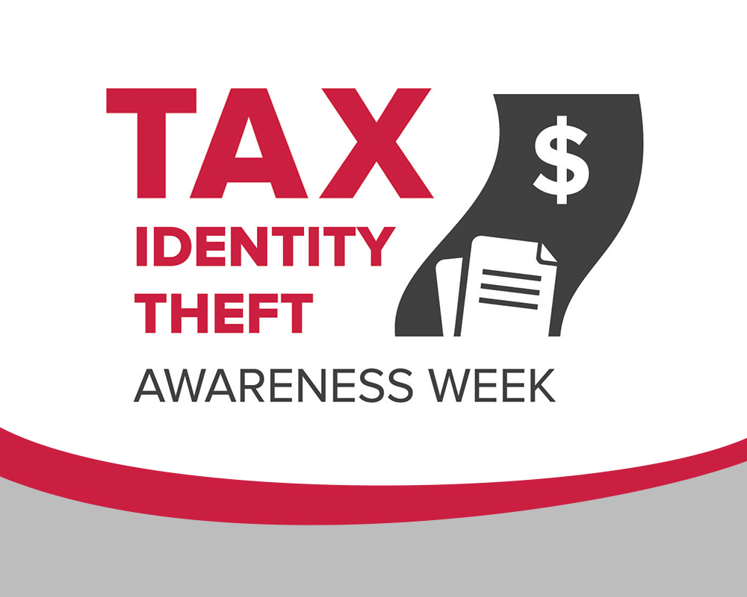

Slide 2




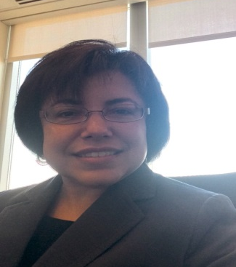

Today’s Speakers
Lisa Weintraub Schifferle
    Attorney
    Federal Trade Commission (FTC)
    Michael Delgado
    Assistant Inspector General for Investigations
    Treasury Inspector General for Tax Administration (TIGTA)
Rosa Maymi
    Project Advisor
    AARP, Education & Outreach

Slide 3
Overview
What is identity theft?
What is tax identity theft?
  How does tax identity theft happen?
  How to lessen your chance of being a victim
  What to do if you’re a victim
New Twist: IRS Imposter Scams

Slide 4

What Is
Identity Theft?

Slide 5
What Is Identity Theft?
Identity theft is the misuse of another’s personal information to:
  fraudulently obtain
    goods or services
    a job
    medical treatment, medications, or equipment
    government services or benefits
  hide from government, law enforcement, or others who perform background checks

Slide 6
Examples of Information Valuable to Identity Thieves
Name, address, telephone number
Date of birth
Social Security number
Medicare card number and health insurance number
Passport number, driver’s license number
Financial account numbers (bank account or credit card numbers)
Passwords (mother’s maiden name, father’s middle name)
Biometric data (fingerprint, iris scan)

Slide 7
How Does Identity Theft Hurt Victims?
Direct financial losses
Damage to financial status, credit score, and reputation
Denial of employment, housing
Problems with IRS
Possible civil judgments or criminal record
Emotional harm
Time and cost of repairing damage

Slide 8
What Is
Tax Identity Theft?

Slide 9
What Is Tax Identity Theft?
Filing a fraudulent tax return using another person’s Social Security number
Claiming someone else’s children as dependents
Claiming a tax refund using a deceased taxpayer’s information
Earning wages under another person’s Social Security number
Notes:
Rosa to cover

Slide 10
Scope of the Problem
FTC statistics:
2012:
  43.4% of all identity theft complaints pertained to taxes or wages
2013:
  30.0% of all identity theft complaints pertained to taxes or wages
2014:
  32.8% of all identity theft complaints pertained to taxes or wages
Source: Consumer Sentinel Network Data Book for January – December 2014

Slide 11
How Victims’ Information is Misused
Source: Consumer Sentinel Network Data Book for January – December 2014

Slide 12
Types of Government Benefits Fraud
Tax or wage-related fraud 32.8%
Gov’t benefits applied for/received 4.1%
Other gov’t docs issued/forged 1.3%
Driver’s license issued/forged 0.5%
TOTAL: 38.7%
Source: Consumer Sentinel Network Data Book for January – December 2014

Slide 13
Imposter Scams – FTC Stats
CY-2013 2,185
CY-2014 52,138
Almost 24 times as many complaints!!!
Notes:
Ask Rosa for AARP #s. Say we’ll hear a lot more about this topic from TIGTA at the end.

Slide 14
How Does
Tax Identity Theft
Happen?

Slide 15
How Does Tax Identity Theft Happen?
Lost or stolen wallets, Medicare cards, smartphones
Theft by family, friends, visitors, advisors
Dumpster diving
Stolen mail or tax returns
Unsolicited calls from telemarketers, prize promoters, etc. asking for personal information
Buying information from corrupt insiders or volunteers at:
  banks, debt collectors
  hospitals, clinics, medical offices, nursing homes
  prisons
  schools, government offices
Corrupt tax preparation services
Notes:
Rosa to cover

Slide 16
How Does Tax Identity Theft Happen Online?
Data breaches, hacking into computers and networks
Phony emails from imposters
Unsecure Wi-Fi hotspots
Peer-to-peer file sharing
Social networking
Downloading software or apps from unknown sources

Slide 17
Warnings Signs of Possible
Tax Identity Theft
Social Security number is lost, stolen, or compromised
Unusual delay in getting a refund
IRS notification:
  duplicate tax return filing
  unreported income
  duplicate dependents

Slide 18
How To Lessen Your Chance of Being a Victim

Slide 19
Reducing the Risk of Tax Identity Theft
Minimize personal information in purses or wallets, or on smartphones
Shred financial documents before disposing
Don’t give out personal information unless you know who’s asking for it and why they need it
Keep personal information secure — at home, at the office, in your car
Don’t click on links sent in unsolicited email

Slide 20
Reducing the Risk (cont.)
Monitor accounts and review financial statements regularly
Watch mail for statements for accounts or credit cards that you didn’t open
Confirm you get the statements you expect in the mail
Get your free annual credit report at www.annualcreditreport.com
Make a copy of everything in your wallet and store it safely

Slide 21
Preparing and Filing Tax Returns
Know your tax preparer
Mail tax returns as early in the tax season as possible
Do not put tax returns in outgoing mail; mail tax returns directly from post office
If filing electronically, use a secure network and encrypt
Store copies of your returns in a secure place
Shred drafts, calculation sheets, and extra copies
Do not respond to unsolicited emails that appear to be from the IRS

Slide 22
Additional Advice for
Older Americans
Protect Medicare card number, which might be SSN
Protect personal information at home like you would cash or jewelry
Make sure to open and review your mail and email
Ask medical and care facilities about their data protection policies
Select assistants and other support professionals with care
Notes:
Rosa to cover

Slide 23
What to Do If You’re a Victim

Slide 24
Steps for Tax Identity Theft Victims
Contact the IRS Identity Protection Specialized Unit at
800-908-4490 (8 a.m. to 8 p.m., local time)
File IRS Identity Theft Affidavit (Form 14039)
Have valid identification (government-issued identification: Social Security card, driver’s license, or passport)
When your case is resolved, you will be issued an Identity Protection PIN
Go to: irs.gov/identitytheft

Slide 25
Steps to Prevent More Harm
Contact credit reporting agencies
  place a fraud alert
  consider a credit freeze
  request and review your credit report
File a complaint with the FTC at 877-ID-THEFT
File a police report
Contact the companies where fraud occurred

Slide 26
Fraud Alerts
90 days
Renewable for 7 years
Entitles victim to one free credit report
Need to call only one of the three credit reporting agencies; it will notify the others:
    Equifax: 800-525-6285
    Experian: 888-397-3742
    TransUnion: 800-680-7289
Creditors must take “reasonable steps” to verify your identity

Slide 27
Credit Freezes
Must request in writing from each credit reporting agency
Blocks all new credit
Effective until lifted
Possible fees, if no accompanying police report or Identity Theft Report

Slide 28
New Twist:
IRS Imposter Scams

Slide 29
What are IRS Imposter Scams?
Scammers posing as the IRS call and say you owe taxes
They might also:
  threaten to arrest or deport you if you don’t pay
  know all or part of your SSN

Slide 30
What are IRS Imposter Scams? (continued)
  They might also:
  rig caller ID to make it look like call is from DC (202 area code) so you think it is the IRS
  Demand immediate payment by pre-paid debit card or wire transfer
  Send you bogus IRS emails to further the scheme

Slide 31
IRS Imposter Scams –
Who is Affected?
Largest telephone scam in TIGTA’s history
300,000+ contacts across the US
Over $14M paid to scammers
Top 5 states* affected (by dollar loss):
  1. California 4. Pennsylvania
  2. Florida 5. New Jersey
  3. New York
*As of January 2015

Slide 32
IRS Imposter Scams –
What You Need to Know
The IRS will not ask you to pay with prepaid debit cards or wire transfers
The IRS will not ask for a credit card number over the phone
  The IRS will not threaten arrest, deportation or loss of your drivers license
  The IRS will not send you emails

Slide 33
IRS Imposter Scams –
What You Need to Know (continued)
If the IRS needs to contact you, they will first do it by mail
If you have any doubts, call the IRS directly at 800-829-1040

Slide 34
Report IRS Imposter Scams
TIGTA = Treasury Inspector General for Tax Administration
  http://www.treasury.gov/tigta/contact_report_scam.shtml
  800-366-4484
FTC
  ftc.gov/complaint
  877-FTC-HELP

Slide 35
Resources

Slide 36
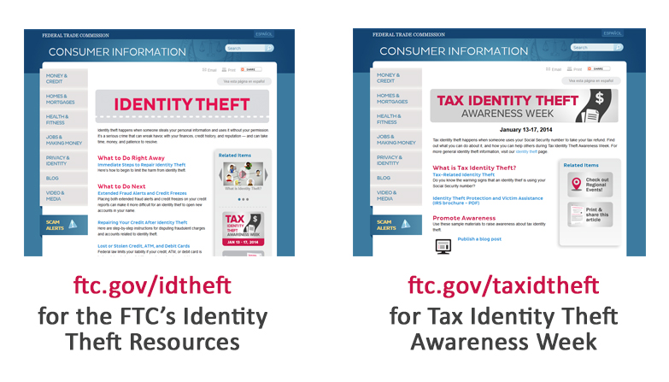

Slide 37
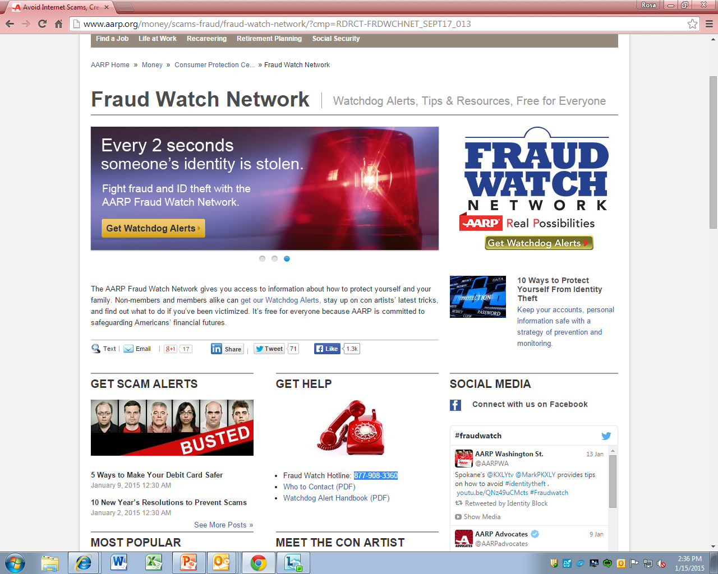
AARP Fraud Watch Network aarp.org/FraudWatchNetwork
Notes:
Rosa to cover

Slide 38
Resources
FTC: ftc.gov/idtheft
ftc.gov/taxidtheft
IRS: irs.gov/identitytheft
TIGTA: treasury.gov/tigta
AARP: aarp.org/fraudwatchnetwork and 877-908-3360
aarp.org/scamalert
Dept. of Justice - Office for Victims of Crime (OVC): ovc.gov
National Identity Theft Victims’ Assistance Network (NITVAN):
identitytheftnetwork.org
Identity Theft Resource Center (ITRC): idtheftcenter.org

Slide 39
Questions?

